Slide 1
Biodiversity in Urban Areas

Slide 2
Video
Why is Biodiversity so Important?

Slide 3
Learning Targets
I can:
Explain how certain actions can increase biodiversity with urban areas and make recommendations.
I have:
Looked at an urban area and made chosen and justified three ways in which biodiversity can be increased.

Slide 4
Brain Race!
Your group will be given a piece of paper and have to write down a list of potential answers to a given question.
Write down ONE answer and the pass the paper clockwise.
The team with the most correct answers in two minutes wins!
QUESTION:
What can help increase the amount of animals and plants in a city?

Slide 5
Example Answers (teacher only)
Plant trees – planting more trees, especially large native trees, will give animals and other plants more food and more areas in which they can live.
Decrease traffic – by decreasing traffic, animals will be more likely to enter the area. The amount of waste and litter will also decrease, making the area less dangerous for living things.
Add or clean water resource–a pond or a stream would work best, but even a fountain can provide birds, rodent and other creatures with water.
Introduce species that are locally extinct – once the above is done, physically moving species to the area would increase the biodiversity immediately.
Add bird boxes – Bird boxes are cheap, easy to make, an will increase the amount of birds in the area.
Add natural pathways – Animals like to migrate, and some seeds are spread by the wind, and natural pathways allows them to travel naturally to different areas.

Slide 6
Video: Biodiversity in Australian Cities
Watch the video and respond to the questions
Cities are often founded in areas that:
    Have limited natural resources and low biodiversity.
    Have many natural resources and low biodiversity.
    Have limited natural resources and high biodiversity.
    Have many natural resources and high biodiversity.
How will the population of cities in Australia change in the lext 25-30 years?
What is the ‘extinction of experience’?

Slide 7
Station Learning: How can we increase biodiversity in urban environments?
Drop in at each table to make notes on your worksheet about the different ways that you can increase biodiversity. You will have four minutes at each station. Spend two minutes answering the question on one side of the print out at the station, and the next two minutes reading the answers and making notes.
Station 1: Decrease Traffic
Station 2: Add water sources
Station 3: Reintroduce species
Station 4: Plant management
Station 5: Add natural pathways

Slide 8
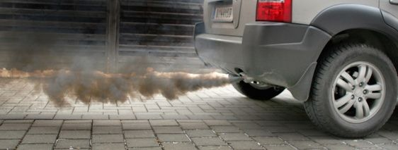
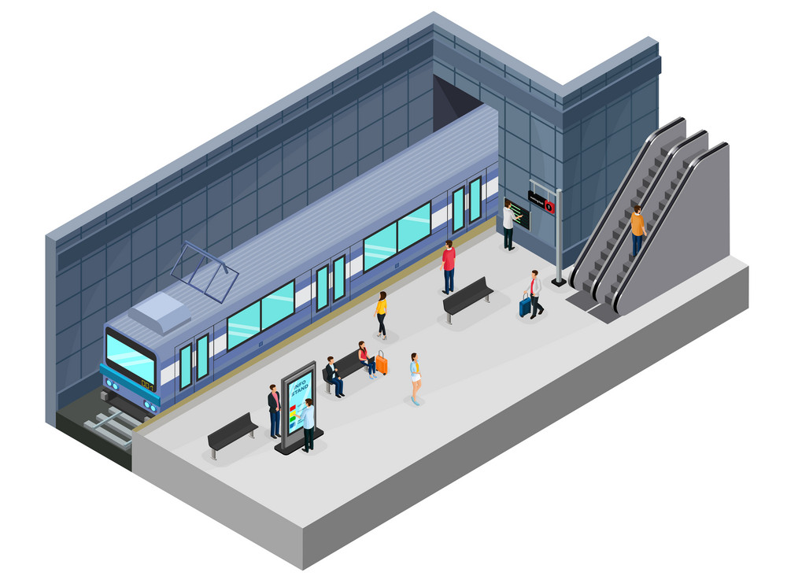
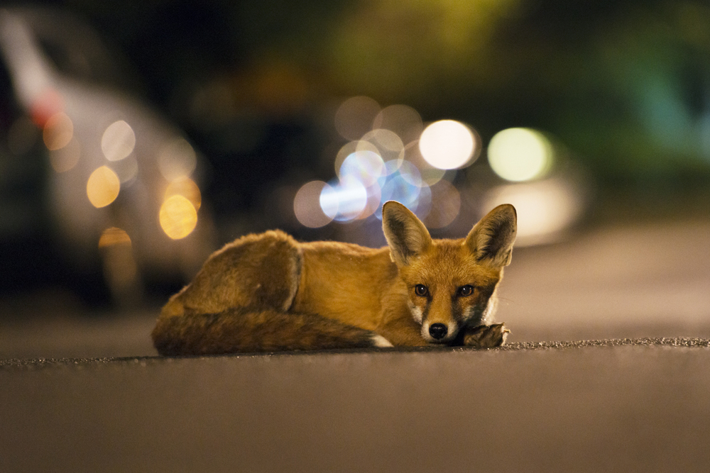
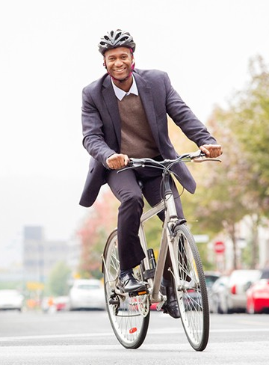

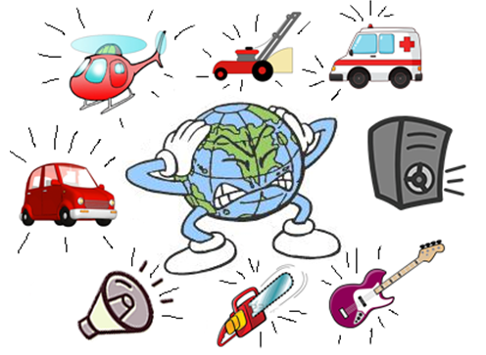
Station 1: Decrease Traffic
Question: How can traffic be decreased in a big city? What would the advantages be? (Hint: Use the pictures to help!)

Slide 9
Station 1: Decrease Traffic
Traffic can be decreased by:
Encouraging public transport
    Cheap public transport (Hong Kong)
    Emissions (pollution from vehices) Tax for those driving within the city (London)
Providing more opportunities for public transport within the city
    Regular bus stops/subway stations/tram stops
    More bus routes/subway lines/tram lines
Encouraging working form home when possible
    Most journeys in a city are by people travelling to and from work. With modern technology, working from home is a viable (possible) alternative.
Encouraging cycling to work
    Bicycles require a lot less space do not have emissions.
Advantages of decreasing traffic:
less air pollution - higher quality air– improved public health
- less noise pollution - fewer traffic accidents - less danger and more space for wildlife – less reliance on fossil fuels

Slide 10
Station 2: Water Management
Question: You have already learned about water management within cities. What can you remember?

Slide 11
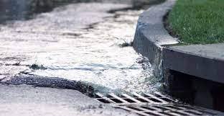
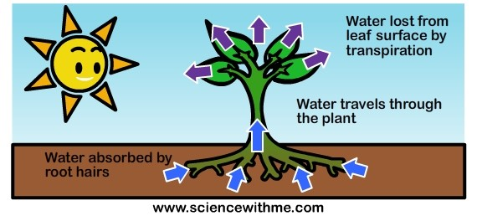
Station 2: Water Management
Flooding can cause the death of flora and fauna. However, managing stormwater run off through the use of rain gardens, storm water planters, rain barrels and bioswale can help avoid flooding.
Introducing sprinklers can also help water dry areas where rain water is inconsistent.
Use of natural fertilizers instead of chemical fertilizers which run into city waters.
Planting plants that are native to river edges will help attract more species, protect the ecosystem from excess water and provide a buffer between pollution and the fresh water.

Slide 12
Station 3: Species Reintroduction
Reintroducing species is when a locally extinct (extinct in the local ecosystem, but not extinct in other places) species is moved into the ecosystem that no longer had it.
Question: What are the advantages and disadvantages of reintroducing species that are no longer present in the city?

Slide 13
Station 3: Species Reintroduction
Advantages
Disadvantages
A direct and time effective method.
Natural climate will be suitable to the species.
It keeps the character of the natural environment.
Species may try to migrate back to their original location.
The species could disrupt the food web, lowering the numbers of other species.
It could be costly to move certain species.

Slide 14
Station 4: Plant Management
Question: It is obvious that having more plant life is one of the first steps towards having a greener city. But how are plants managed throughout the city? What do you think is involved in maintaining them?

Slide 15
Station 4: Plant Management
Regular surveying can help you tell which plants are thriving and which are struggling.
Mowing grassy areas regularly and deweeding can allow more productive plantlife to grow by limiting the amount of weeds.
Planting different plants in different seasons can help the green space become more resistant to seasonly weather changes.
Regularly searching for signs of disease in the plants.

Slide 16
Station 5: Natural Pathways
Question: Natural pathways are connections between two or more natural place, but how can we connect natural places to each other?

Slide 17
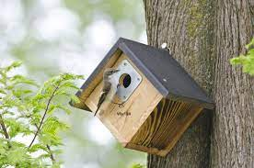
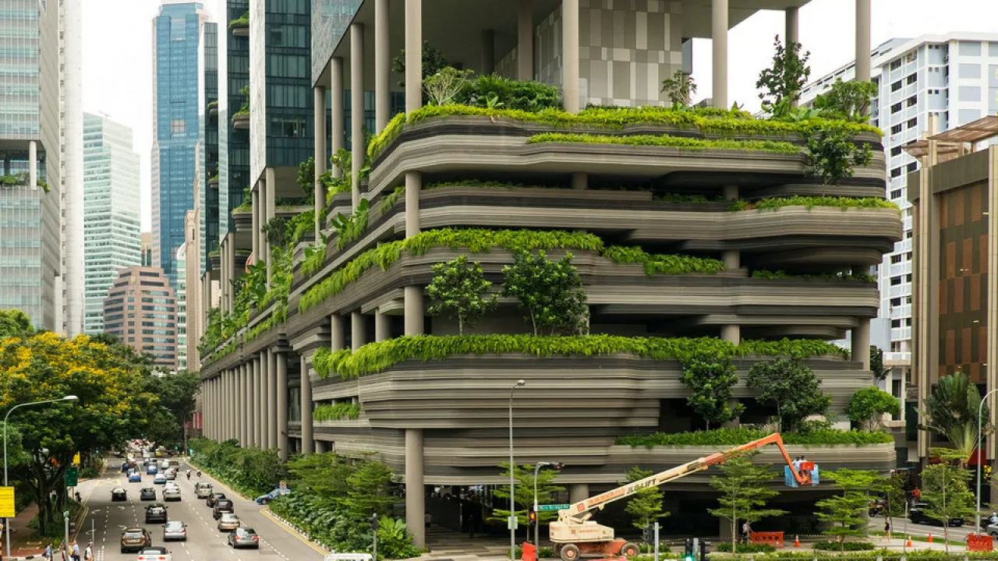
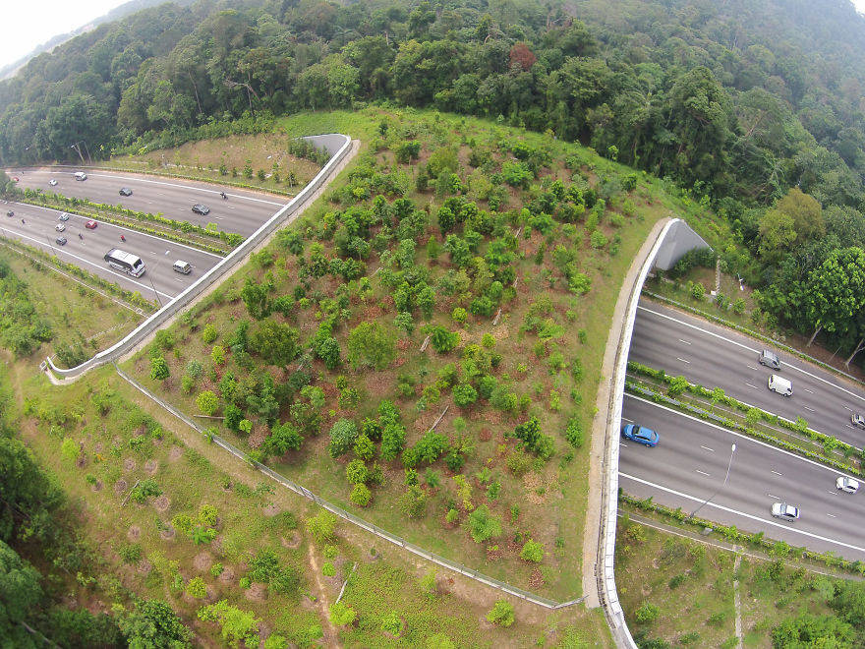
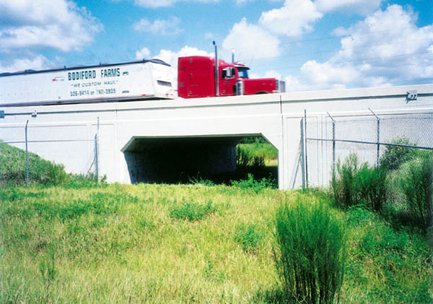
Station 5: Natural Pathways
Animal bridges or tunnels for wildlife to travel between areas. This will help species distribution. It will also help avoid traffic accidents (improving road safety) and roadkill (improving cleanliness)
Green buildings can provide animals with a place to live between green spaces. The small creatures that live in the pathways will provide food for larger creatures in the green spaces that it is connecting.
Bird boxes between green spaces can provide birds with a place to live and rest between green spaces. If bird boxes are between two green spaces, the potential food increases.

Slide 18
Research Rush: How can we measure biodiversity?
Step One: Individually, spend 5 minutes researching how biodiversity can be measured, and whether this would work in an urban environment. Note down your findings.
Definining the following terms will help you:
Species Richness
Species Evenness
Bio-indicators
Native Species
Step Two: Share what you have found in a round robin.

Slide 19
How can we measure biodiversity?
We can find:
Species Richness: The amount of species in an area
Species Evenness: The distribution of species in an area, and how equal they are.
By using:
Bio-indicators: To use species, such as birds, that are easily visible to make an estimate of the amount of other species in the area through our knowledge of food webs and pyramids.
Native species: Species that naturally live in the area

Slide 20
Where will your Green Urban Space be and how will it increase the biodiversity?
Spend the rest of the lesson thinking about and answering the question above.

Slide 21
Learning Targets
I can:
Explain how certain actions can increase biodiversity with urban areas and make recommendations.
I have:
Looked at an urban area and made chosen and justified three ways in which biodiversity can be increased.

