Slide 1
Gardens in the City
Explore the ways in which gardens model natural, cooperative living systems.
Make connections with what you are learning in Science about green cities, and the actions one can take in the real-world.
Notes:
For this lesson it would be useful to have students divided into groups of 4-5

Slide 2

Urban Gardens- Video
Notes:
Video is embedded and linked if embedded video does not work.

Slide 3

Round Robin
On the next slide are four questions related to the urban garden video.
In intervals of one minute, have a continuous round robin discussion, with the first student answering question 1, the next question 2 and so on, until all 4 questions have been answered.
After all questions have been answered, continue for one further round. This time when it is your turn, you may choose any of the questions. Add further details and ideas, or offer a different perspective from what your classmates have already shared.

Slide 4
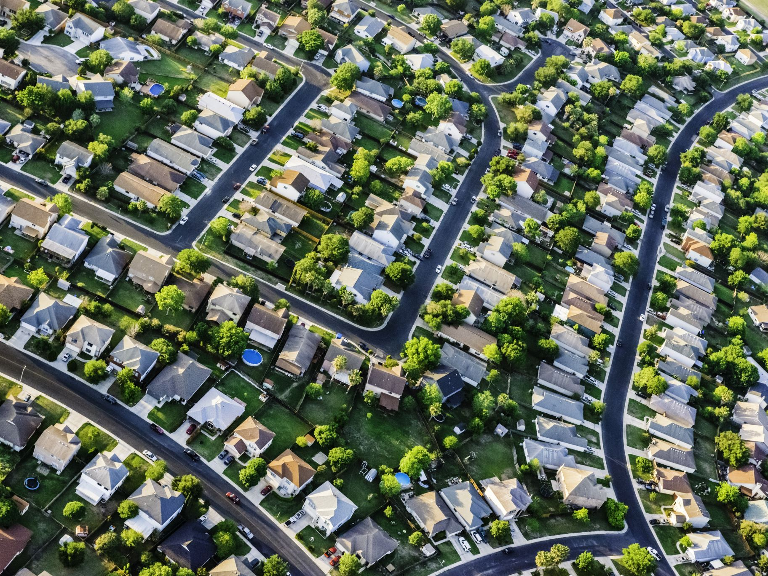
Round Robin Discussion
1. What makes a garden “a complete mini-ecosystem”?
2.What examples of interactions did you see in the video? What are some interactions in a garden/ ecosystem that you cannot see?
3. How does a garden function as a mini-farm?
4. How does a garden function as a mini-watershed?

Slide 5
Watch
Urban Habitat Biodiversity in Cities (4:24mins)
Prompts | Notes
1. Before watching: Besides plants, what organisms do you think you’d typically find in an urban garden? What have you noticed in your own neighbourhood?
2. After watching, reflect: Why is more biodiversity generally preferable in regard to the health of an ecosystem?

Slide 6

Essential Question
How can we use urban gardens to better support ecosystems in our cities?
Think-Write-Share
In my opinion, ...

Slide 7




Transfer Learning; Create Links Between Subjects
Science
Design & Technology

Slide 8
Links to design: discuss…
Where might be the best placements for urban gardens?
What needs to be considered when choosing the plants and design for an urban garden?
What background knowledge (content) can you transfer from this lesson into your design lesson when considering the design elements of a green urban space?

Slide 9
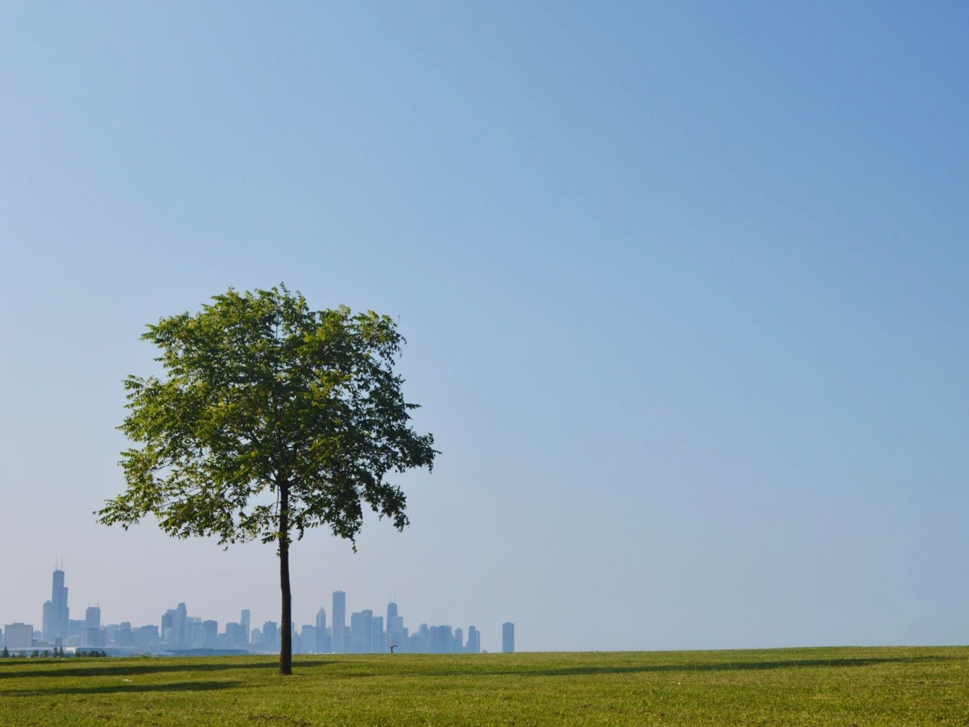
Follow-on
On your next walk around your neighbourhood, see if you can spot urban gardens and consider what ecosystems those gardens may be supporting.

