Slide 1
URBAN TREES
Interdisciplinary Unit- Science & Design
Green Urban Spaces

Slide 2
Learning Targets
At the end of this topic I will be able to… | Explain how trees benefit urban environments.
To do this, I must understand that… | Trees have economical, societal and environmental advantages.
To show I can understand this I will… | Reflect on a video and create an infographic about the importance of trees.

Slide 3
Warm-up Questions
What are the benefits of trees in a city?
If you were choosing somewhere to live, would the amound of trees in the area be important to you?

Slide 4
Plan for 1 Period
Run through the inquiries with the class briefly (5 minutes)
Video (5 minutes)
Brainstorm session (5 minutes research + 1 minute each for discussion using Round Robin), each group will have to note down on the small whiteboard
Discuss the inquiries now in more details using slides 5 – 10 (15 minutes) through interaction

Slide 5
Inquiries
(B) Community & Social Value
(A) Ecological & Environmental Value
(B) Personal & Spiritual Value
(A) Practical & Commercial Value
(B) Property & Economic Value
Think-Pair-Share– Define the terms above and give an example. It does not matter if you are not 100% sure. Just share what you think.

Slide 6
You are going to watch a video about the value of trees – complete the “Before Watching” section of your worksheet.
Spend four minutes doing a Research Rush to define the following terms:
Uruk (Proper Noun)
Anuradhapura (Proper Noun)
Irrigation System (Noun Phrase)
Elaborate (Adjective)
Sacred (Adjective)
Reverence (Noun)
Contaminate (Verb)
Mineral Deposits (Noun phrase)
Agriculture (Noun)
Toxins (Noun)
Pollutants (Noun)
Porous (Adjective)
Arboreal (Adjective)
Infrastructure (Noun)
Bronchitus (Noun)
Arteries (Noun)
Biodiversity (Noun)

Slide 7


Slide 8
Brainstorm
Group | Topic
1 | Community and Social Value
2 | Ecological and Environmental Value
3 | Personal & Spiritual Value
4 | Pratical and Commercial Value
5 | Property Value and Economic Value

Slide 9
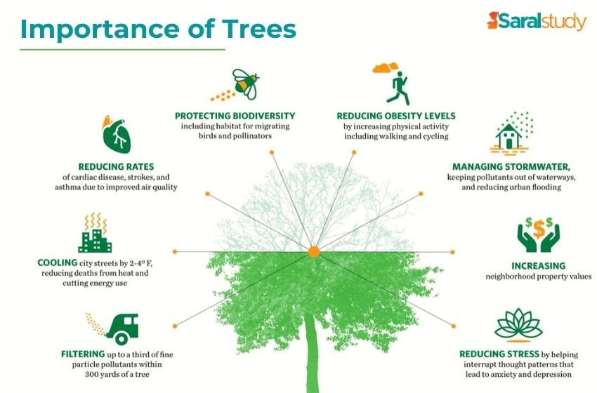

Slide 10
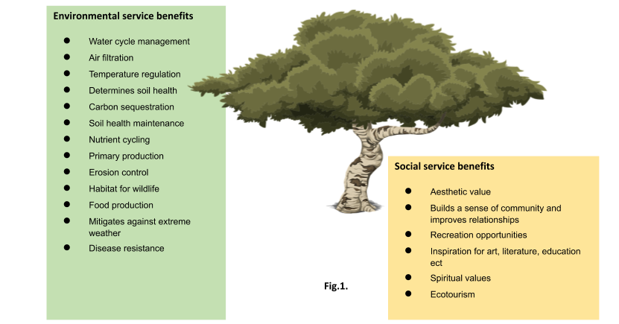
Environmental & Social Values

Slide 11
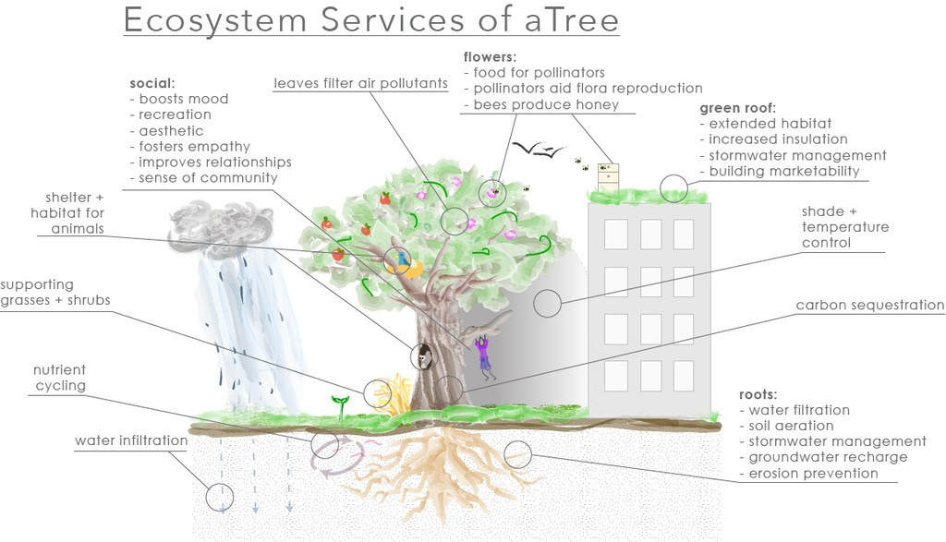

Slide 12
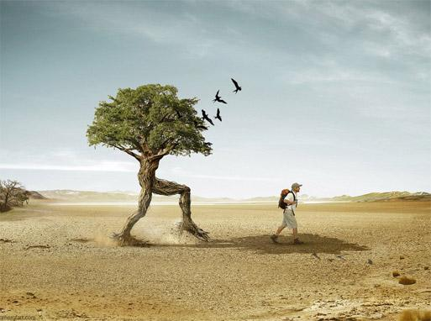
Personal & Spiritual Value
The main reason we like trees is because they are both beautiful and majestic. Most of us react to the presence of trees with a pleasant, relaxed, comfortable feeling. In fact, many people plant trees as living memorials of life-changing events.
Trees help record the history of your family as they grow and develop alongside you and your kids. We often make an emotional connection with trees we plant or become personally attached to the ones that we see every day.

Slide 13
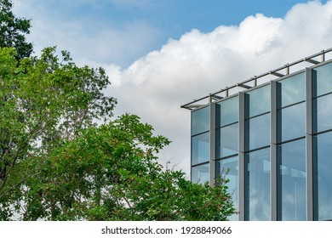
Practical & Commercial Value
They have a wide variety of practical and commercial uses. Wood was the very first fuel, and is still used for cooking and heating by about half of the world’s population. Trees provide timber for building construction, furniture manufacture, tools, sporting equipment, and thousands of household items. Wood pulp is used to make paper.
Source of chemicals and medicines? Quinine and aspirin are both made from bark extracts. The inner bark of some trees contains latex, the main ingredient of rubber. How many more uses can you name?

Slide 14
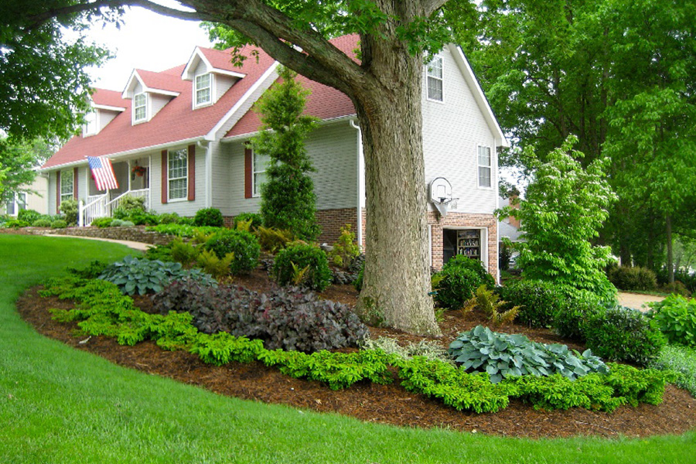
Property Value & Economic Value
“Trees properly placed around buildings can reduce air conditioning needs by 30% and save 20-50 percent in energy used for heating.”

